Slide 1
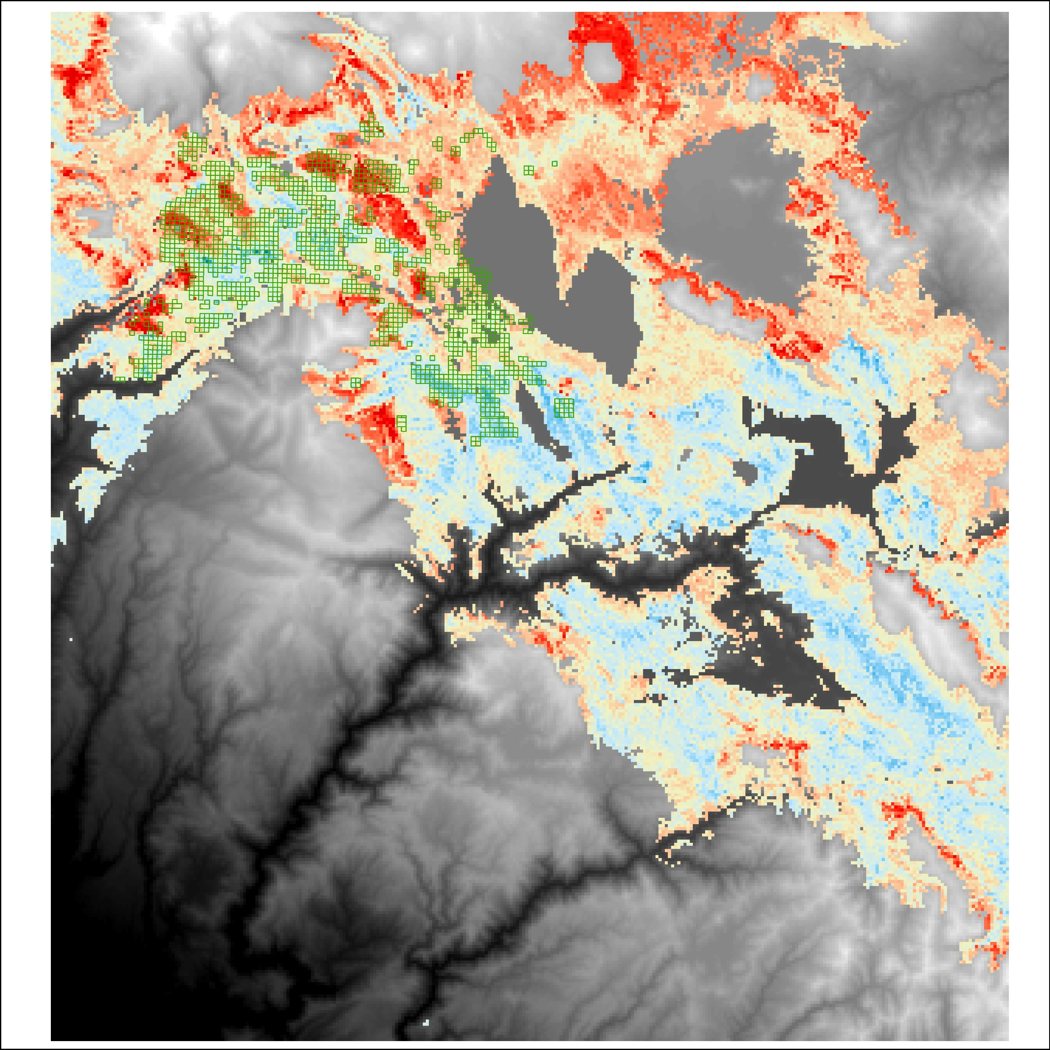
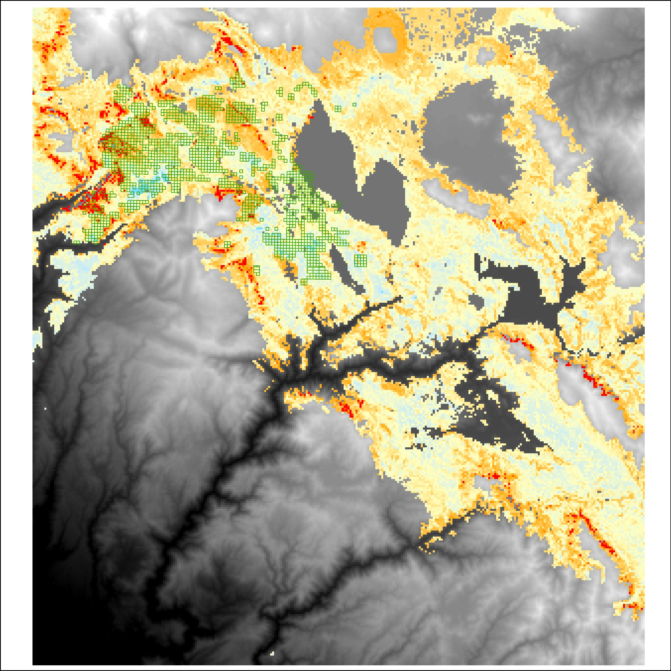
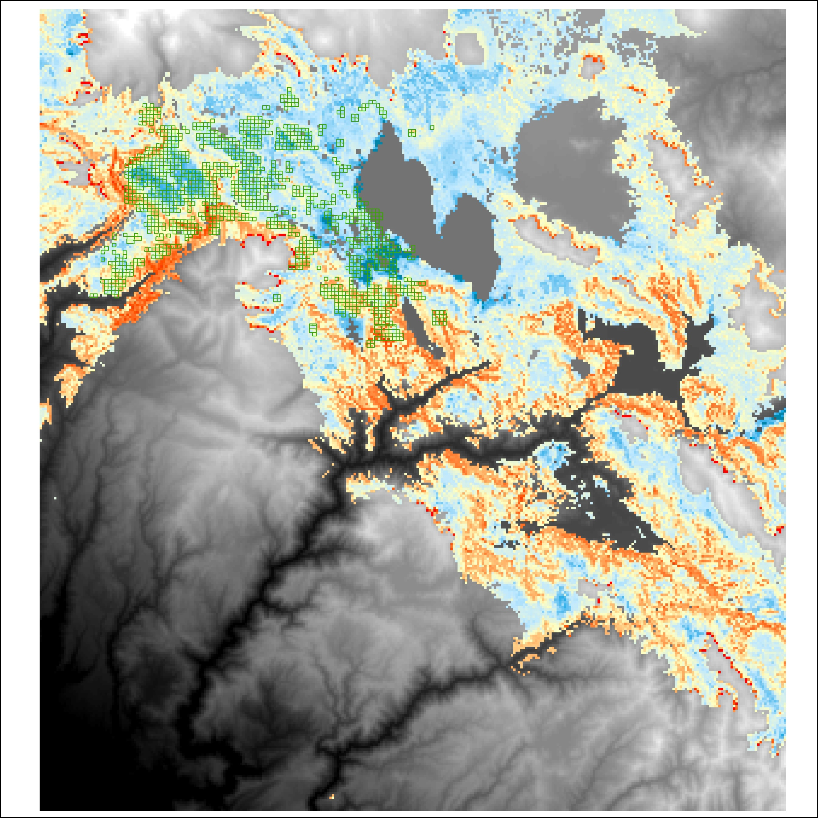
Sampled QQs
Sampled QQs
Predicted TPH
Predicted BA
(m² ha⁻¹)
29
34
10
39
13
44
16
49
19
54
22
Elevation (m)
Elevation (m)
0
2736
0
2736
Sampled QQs
Predicted pine fraction
0.38
0.48
0.58
0.68
0.78
0.88
Elevation (m)
0
2736

